Slide 1
COCA COLA & AI
Dan Haryosasongko
https://www.artificialintelligence-news.com/2019/05/07/how-coca-cola-is-using-ai-to-stay-at-the-top-of-the-soft-drinks-market/

Slide 2
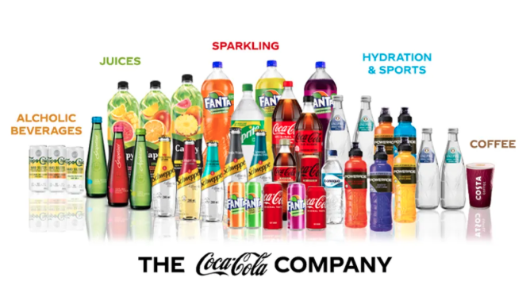
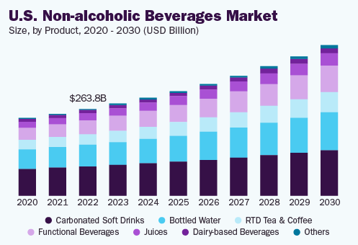
Non Alcoholic is a big market and it is growing and Softdrinks is having more competitors
Key Non-alcoholic Beverages Companies:
Nestlé
PepsiCo
Unilever
Keurig Dr. Pepper Inc.
The Coca-Cola Company
Jones Soda Co.
Danone S.A
Suntory Beverage & Food Ltd
Asahi Group Holdings, Ltd.
Red Bull
https://www.grandviewresearch.com/industry-analysis/nonalcoholic-beverage-market

Slide 3
Coca-Cola challenge versus Competition
Coca-Cola need to concur some challenges:
Market Dynamic : Carbonated drink not only competing within themselves but also with mineral water, juice especially as health-conscious is raising & economic situation
Consumer Preference : Every person has already some preference in their choice of drink and growing demand on low sugar / sugar free
Competition : Competitors continuously innovate and introduce new products, flavours, and packaging formats

Slide 4
Coca-Cola uses AI to help anticipate the change & competition
Steps on Coca-Cola in using AI :
Coca-Cola make AI Algorithm in their vending machine to explore their customer habits back in 2014
Launched App Coca-Cola Freestyle so consumer can mixed up the flavor
Coca-Cola launched new taste with name Coca-Cola Y3000 in Sep 2023 for limited edition in several countries

Slide 5
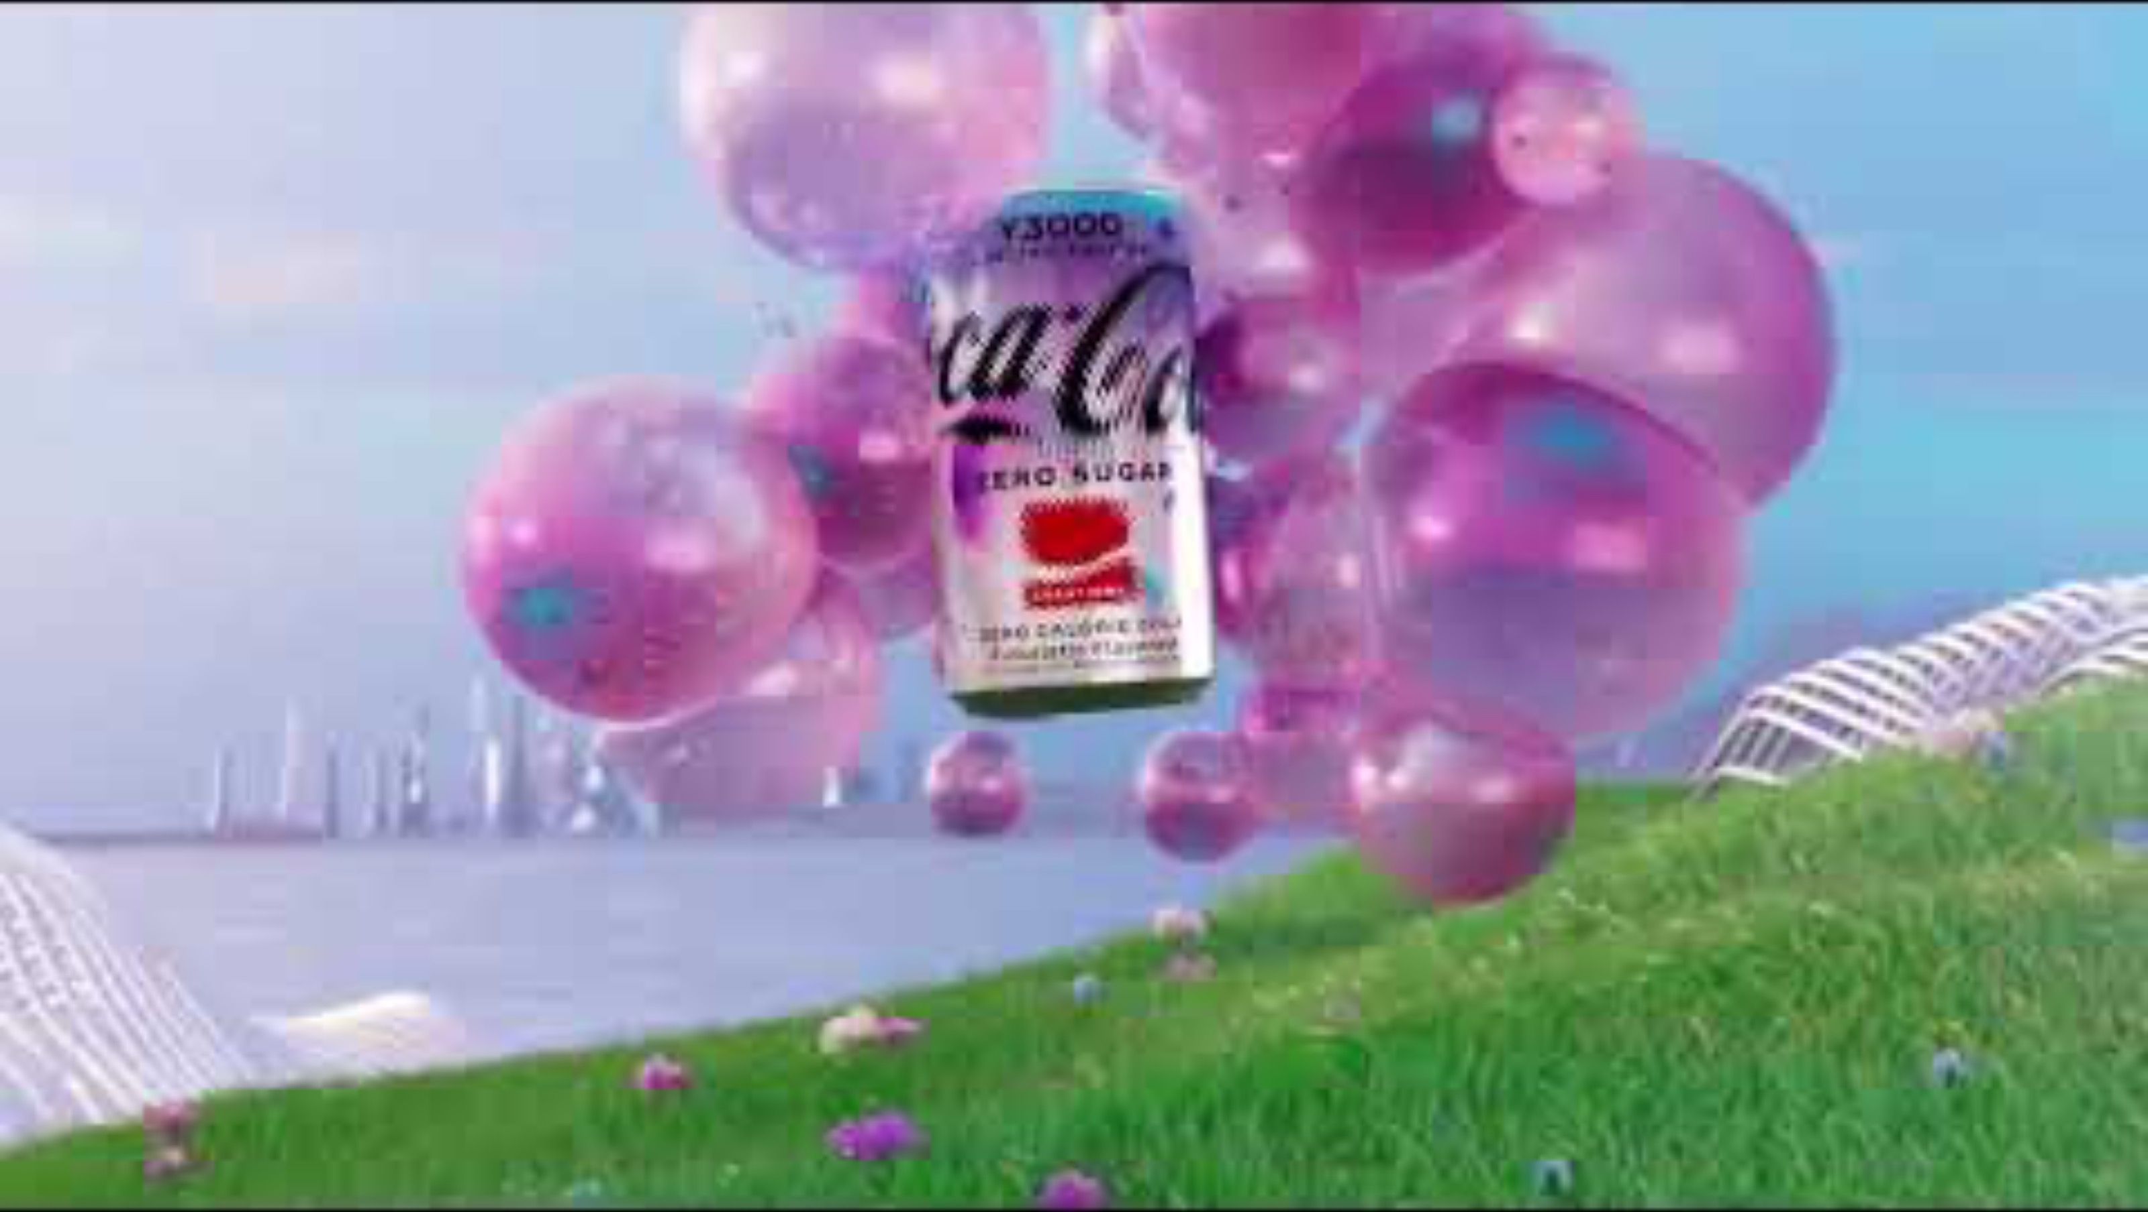
“the first futuristic flavour co-created with human and artificial intelligence.”

Slide 6
Coca-Cola Y300 Taste
Review No. 1: “Its flavour reminds me of when you mix all the drinks together at a soda fountain. It’s artificially fruity, like a gummy bear or a lollipop. The aftertaste is more of a caramel, vanilla flavour,”
Review No. 2: “There’s a tasty berry vanilla flavour at first, but the aftertaste sometimes reminds me of buttered popcorn jelly beans. That aftertaste was more noticeable after using Y3000 to soothe my mouth after eating some Takis,”. “But other times, that aftertaste wasn’t buttery and leaned heavily towards vanilla-y. I think I also picked up on some artificial banana flavouring.”
Review No. 3: “I was kind of surprised the drink poured out with the traditional cola colour, because it tasted like all the red soda flavours got together and threw a party. Cherry, strawberry, raspberry, generic ‘fruit punch’ — those were the tastes I sensed most. I’m not a big fan of the taste of energy drinks, but the Y3000 did remind me of those, too,”

Slide 7
